Slide 1

Predicting Demand in an Hourly and Daily Basis

Slide 2
Introduction:
Research Focus: This study centers around understanding and addressing critical healthcare challenges related to Emergency Department demand, with a particular emphasis on One Hospital
Research Purpose: Spanning a period of 12 weeks, we conducted comprehensive research and in-depth analysis to derive valuable insights into the utilization of services within the Emergency Department and to predict future demand.
Objective: The primary objective is to analyze Emergency Department service usage and predict future demand for this specific healthcare area.
Importance: This analysis could ensure that Emergency Department resources at Ulster Hospital are optimally allocated, particularly during challenging periods like the winter months
Winter Pressures: The winter months from October to March present unique challenges to Emergency Departments. Analyzing demand and predicting trends during these months would enable better preparedness and resource allocation.
1/29/2024

Slide 3
Winter Pressure
Winter Pressure Defined:
Refers to heightened demand and strain on healthcare systems during the winter months (October to March).
Characterized by increased emergency admissions, hospitalizations, and healthcare service usage.
Often attributed to factors like cold weather, seasonal illnesses, and exacerbation of pre-existing health conditions.
Key Characteristics:
Surge in patient volumes seeking medical care.
Particularly affects the elderly due to cold weather and circulating viruses.
Impact on emergency departments is significant.
Impact on Healthcare Resources:
Challenges in managing capacity and resources.
Longer waiting times, increased bed occupancy rates, ambulance handover delays.
Additional healthcare personnel often needed.
Significance:
Crucial for maintaining high-quality healthcare delivery.
Ensures communities receive timely and appropriate medical care, especially during peak winter demand.

Slide 4
Background
Winter Pressures in Healthcare: Winter pressures represent a recurring challenge for healthcare systems, affecting capacity and service delivery. These pressures manifest as surges in emergency admissions and hospitalizations, often driven by respiratory conditions and worsening chronic ailments.
Vulnerability of the Elderly: The elderly population is particularly vulnerable during the winter months due to the compounding effects of cold weather and circulating viruses. This demographic faces an increased risk of health complications, necessitating specialized care.
Strain on Healthcare Facilities: The surge in admissions, especially during the winter season, strains healthcare facilities, including emergency departments. Hospitals contend with limited bed capacity, prolonged waiting times, and challenges in meeting quality care thresholds.
COVID-19 Impact: In January 2023, healthcare resources faced additional strain with daily averages of over 7,000 COVID-occupied beds and nearly 3,000 flu-occupied beds. These challenges were exacerbated by the ongoing impact of COVID-19.

Slide 5
Background
Longitudinal Analysis: To address these challenges, our study conducted a longitudinal analysis spanning from 2009 to 2023. This analysis revealed a progressive increase in daily patient arrivals at A&E during the winter months (October to March), with notable variability and significant differences between winter and non-winter months.
Objective and Significance: Our research aims to identify demand trends and construct predictive models for daily and hourly patient volumes based on data spanning from 2009 to 2023, with a specific focus on future winter seasons. This objective is significant as precise patient arrival estimates enable healthcare institutions to proactively plan for peaks in demand, enhance resource allocation, and optimize personnel to meet projected demand.
Comprehensive Modeling Approach: To achieve these goals, our study employs a multifaceted modeling ensemble, including ARIMA, regression, random forest, XGBoost, LSTM networks, and polynomial regression, harnessing their respective strengths to deliver accurate forecasting capabilities.

Slide 6

Research Objectives
Objective 1: Quantify Winter Pressures
To analyze historical data spanning from 2009 to 2023 to quantify and understand the extent of rising winter pressures on NHS Emergency Department.
Objective 2: Data-Driven Solutions
To provide actionable recommendations based on the analysis findings and predictive models to enhance resource allocation and preparedness during winter crises.

Slide 7
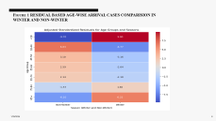

Methodology
Methodology- 1. Study Design and Data Overview:
Quantitative, Observational Study: This study is a quantitative, observational analysis of historical patient visitation data at the ED over 14 years (2009-2023).
Data and Analysis Focus: The study systematically examines various factors, including daily and hourly patient volumes, COVID-19 status, granular temporal variables (day of the week, month, season), triage acuity proportions, ambulance arrivals, and derived attributes.
Filtered Data Scope:
The analysis is concentrated on winter months (January 2009 to June 2023) to develop specialized predictive models for cold seasons, focusing on patient arrivals from October to March due to statistically significant differences in healthcare utilization during these periods.
Age residual analysis highlights increased vulnerability to winter health issues in specific age groups.
Enhanced Predictive Accuracy: By exclusively modeling winter data, the study aims to reduce potential confounding effects and enhance the predictive accuracy of models for colder months, providing actionable insights for winter healthcare challenges. Age residual analysis highlights increased vulnerability to winter health issues in specific age groups.

Slide 8
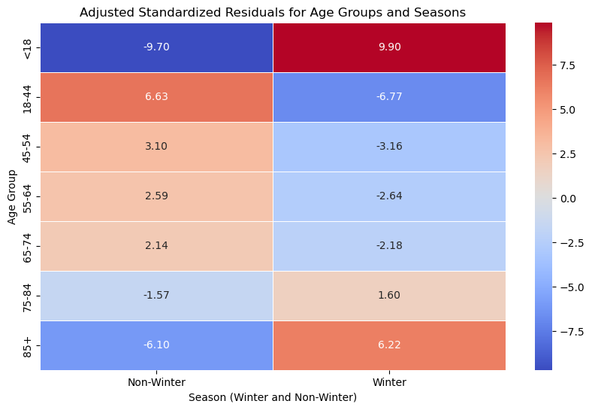
Figure 1 RESIDUAL BASED AGE-WISE ARRIVAL CASES COMPARISION IN WINTER AND NON-WINTER

Slide 9
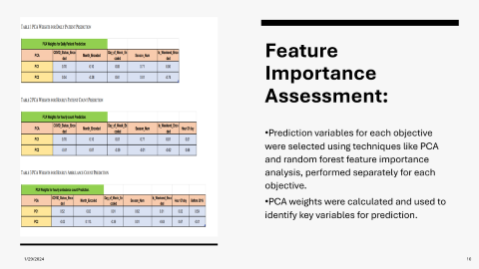

Methodology- 2 Data Processing and Feature Selection:
Predict
Predict Daily Patient Arrivals to ED:
Target Variable: Daily patient count
Extracted relevant input features: COVID-19 status, month, day of the week, season, and weekend indicators.
Feature engineering was applied to structure the data for modeling daily patient arrivals.
Predict
Predict Hourly Patient Arrivals to ED:
Target Variable: Hourly patient count (resulting in 24 predictions per day)
Utilized the same explanatory features as in the daily patient arrivals prediction and Hours classes.
The data was processed at an hourly resolution to enable higher-resolution forecasts for operational decisions and resource allocation.
Predict
Predict Hourly Patients Arriving by Ambulance:
Target Variable: Daily ambulance patient count
Feature selection aligned with the features used in previous and Hour Classes objectives, focusing on those with potential associations with ambulance volumes.
The data underwent feature engineering to create structured inputs for predicting ambulance demand.

Slide 10
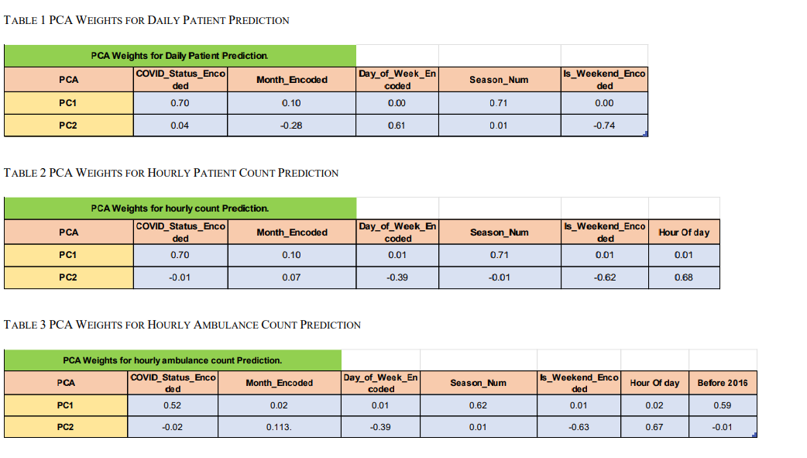
Feature Importance Assessment:
Prediction variables for each objective were selected using techniques like PCA and random forest feature importance analysis, performed separately for each objective.
PCA weights were calculated and used to identify key variables for prediction.

Slide 11
Model Building and Workflow: Figure 2 Machine Learning Model WORKFLOW

Slide 12
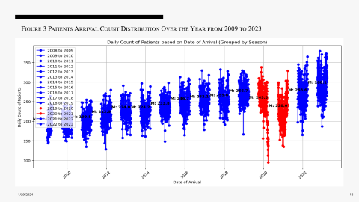

Result – 1- Comprehensive Analysis Key Summary
Patient Volumes & Variability: Gradual increase in mean daily patient arrivals from 2009 to 2023 with growing variability.

Slide 13
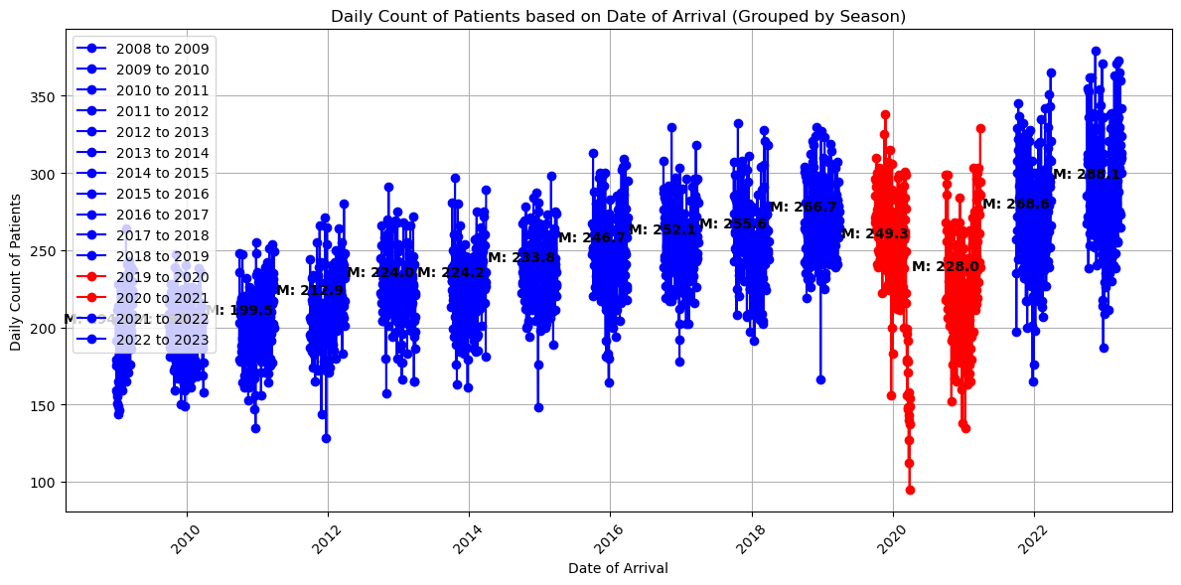
Figure 3 Patients Arrival Count Distribution Over the Year from 2009 to 2023

Slide 14
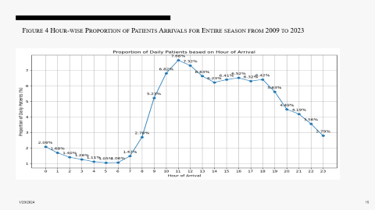
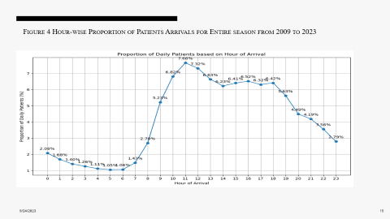
Result – 1- Comprehensive Analysis Key Summary
Patient Volumes & Variability: Gradual increase in mean daily patient arrivals from 2009 to 2023 with growing variability.
Hourly Fluctuations: Consistent hourly fluctuations in daily patient arrivals with peak periods during late morning (11 AM to 4 PM).

Slide 15
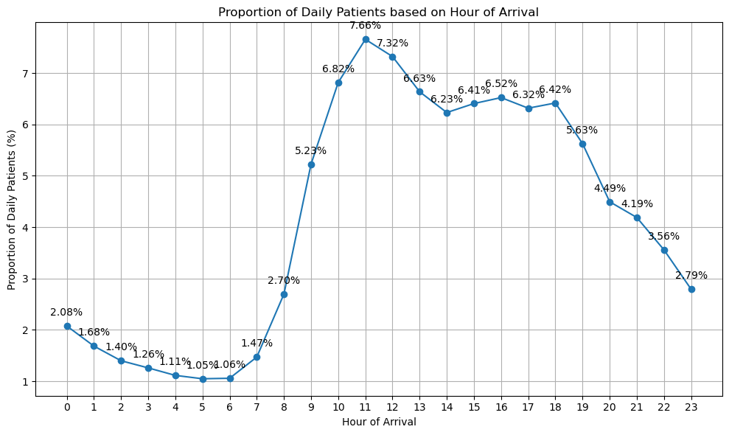
Figure 4 Hour-wise Proportion of Patients Arrivals for Entire season from 2009 to 2023

Slide 16
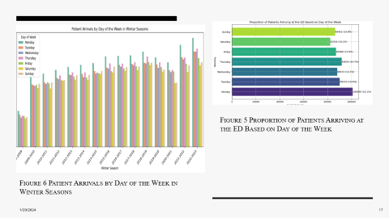
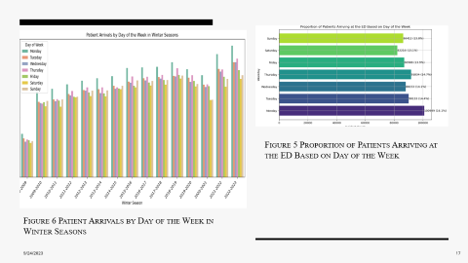
Result – 1- Comprehensive Analysis Key Summary
Patient Volumes & Variability: Gradual increase in mean daily patient arrivals from 2009 to 2023 with growing variability.
Hourly Fluctuations: Consistent hourly fluctuations in daily patient arrivals with peak periods during late morning (11 AM to 4 PM).
Intra-Week Demand: Fluctuations in weekly patient arrivals with Mondays as the busiest day.

Slide 17
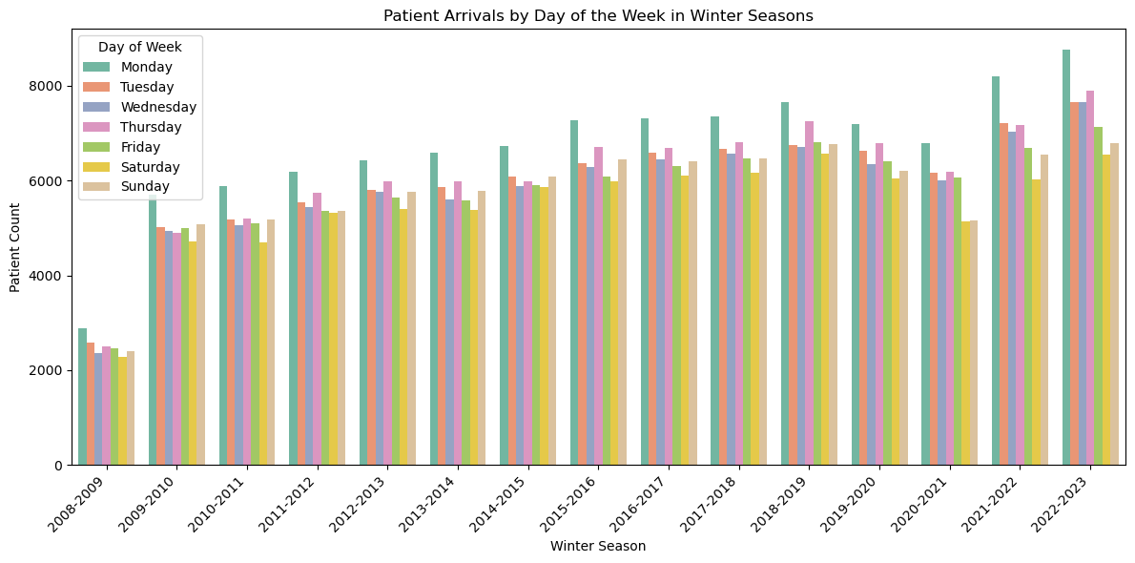
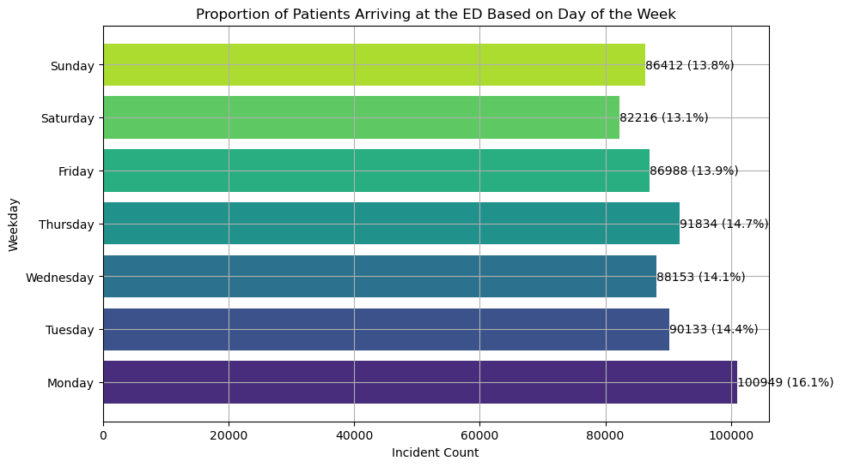
Figure 5 Proportion of Patients Arriving at the ED Based on Day of the Week
Figure 6 Patient Arrivals by Day of the Week in Winter Seasons

Slide 18
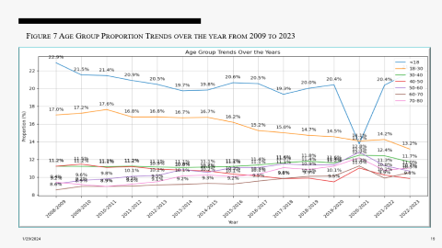
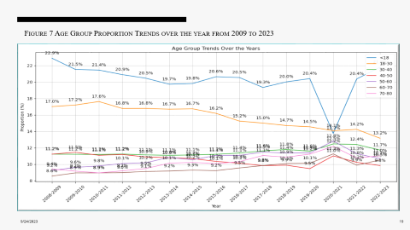
Result – 1- Comprehensive Analysis Key Summary
Patient Volumes & Variability: Gradual increase in mean daily patient arrivals from 2009 to 2023 with growing variability.
Hourly Fluctuations: Consistent hourly fluctuations in daily patient arrivals with peak periods during late morning (11 AM to 4 PM).
Intra-Week Demand: Fluctuations in weekly patient arrivals with Mondays as the busiest day.
Age Group Trends: The ageing population is reflected in increasing trends in <18 and older age groups.

Slide 19
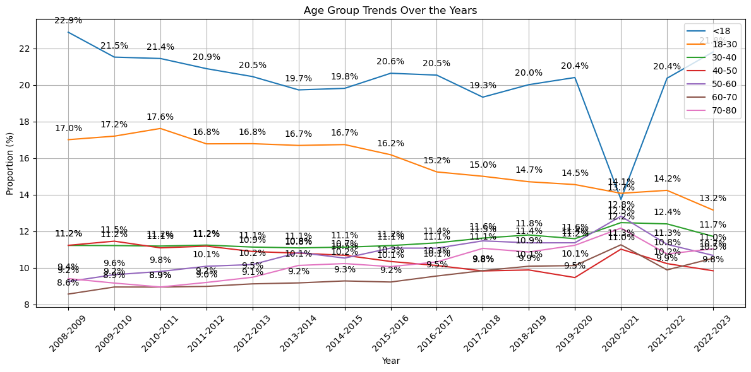
Figure 7 Age Group Proportion Trends over the year from 2009 to 2023

Slide 20
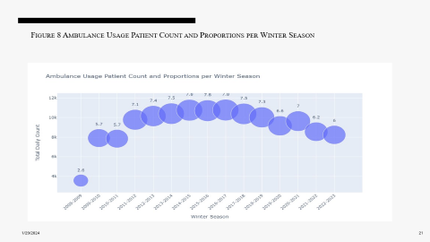

Result – 1- Comprehensive Analysis Key Summary
Patient Volumes & Variability: Gradual increase in mean daily patient arrivals from 2009 to 2023 with growing variability.
Hourly Fluctuations: Consistent hourly fluctuations in daily patient arrivals with peak periods during late morning (11 AM to 4 PM).
Intra-Week Demand: Fluctuations in weekly patient arrivals with Mondays as the busiest day.
Age Group Trends: The ageing population is reflected in increasing trends in <18 and older age groups.
Ambulance Usage: Fluctuating ambulance demand, peaking in 2014-2015 and gradually declining.

Slide 21
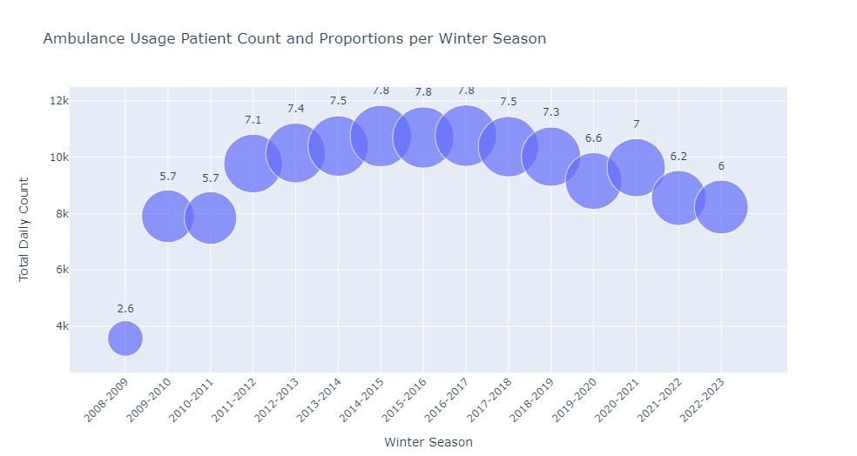
Figure 8 Ambulance Usage Patient Count and Proportions per Winter Season

Slide 22
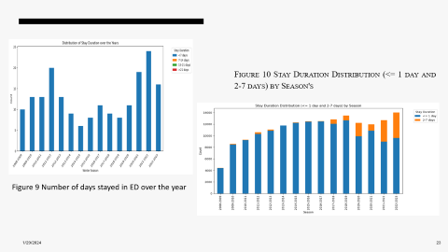

Result – 1- Comprehensive Analysis Key Summary
Patient Volumes & Variability: Gradual increase in mean daily patient arrivals from 2009 to 2023 with growing variability.
Hourly Fluctuations: Consistent hourly fluctuations in daily patient arrivals with peak periods during late morning (11 AM to 4 PM).
Intra-Week Demand: Fluctuations in weekly patient arrivals with Mondays as the busiest day.
Age Group Trends: The ageing population is reflected in increasing trends in <18 and older age groups.
Ambulance Usage: Fluctuating ambulance demand, peaking in 2014-2015 and gradually declining.
ED Stay Durations: Shift towards more extended ED stays post-2017, especially during COVID-19.

Slide 23
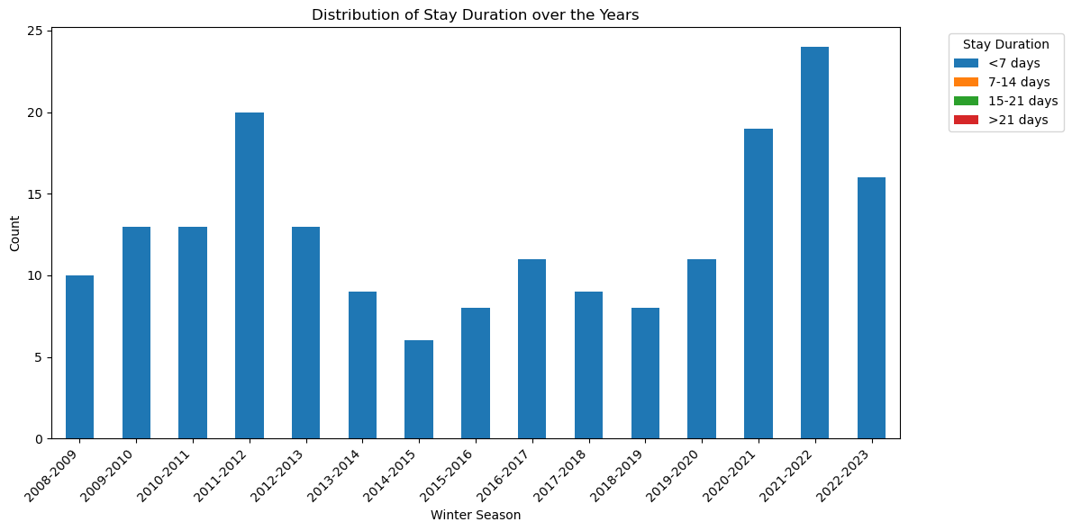
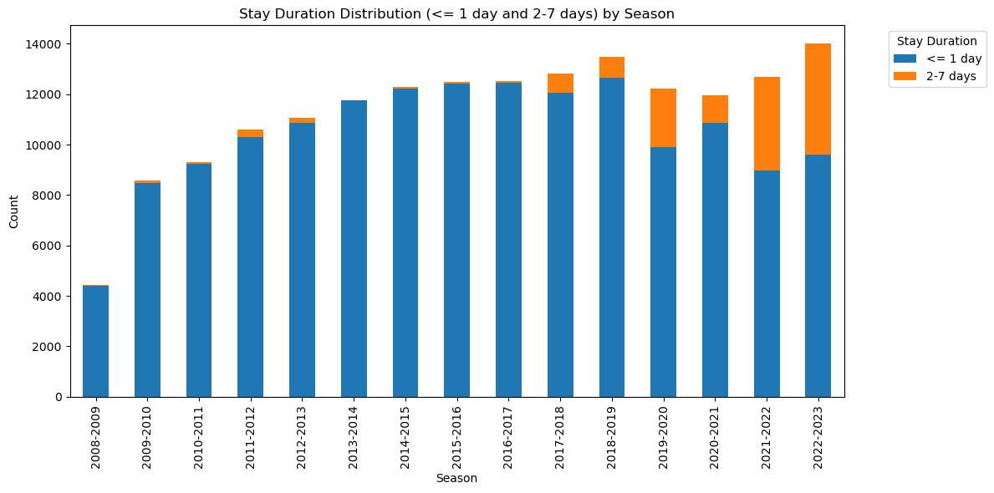
Figure 10 Stay Duration Distribution (<= 1 day and 2-7 days) by Season's
Figure 9 Number of days stayed in ED over the year

Slide 24
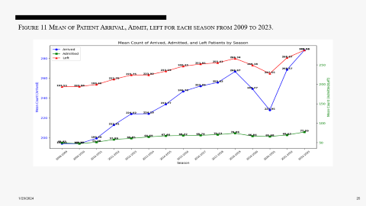

Result – 1- Comprehensive Analysis Key Summary
Patient Volumes & Variability: Gradual increase in mean daily patient arrivals from 2009 to 2023 with growing variability.
Hourly Fluctuations: Consistent hourly fluctuations in daily patient arrivals with peak periods during late morning (11 AM to 4 PM).
Intra-Week Demand: Fluctuations in weekly patient arrivals with Mondays as the busiest day.
Age Group Trends: The ageing population is reflected in increasing trends in <18 and older age groups.
Ambulance Usage: Fluctuating ambulance demand, peaking in 2014-2015 and gradually declining.
ED Stay Durations: Shift towards more extended ED stays post-2017, especially during COVID-19.
Arrival-Departure Equilibrium: Consistent balance between mean daily arrivals and departures, highlighting adaptability.

Slide 25
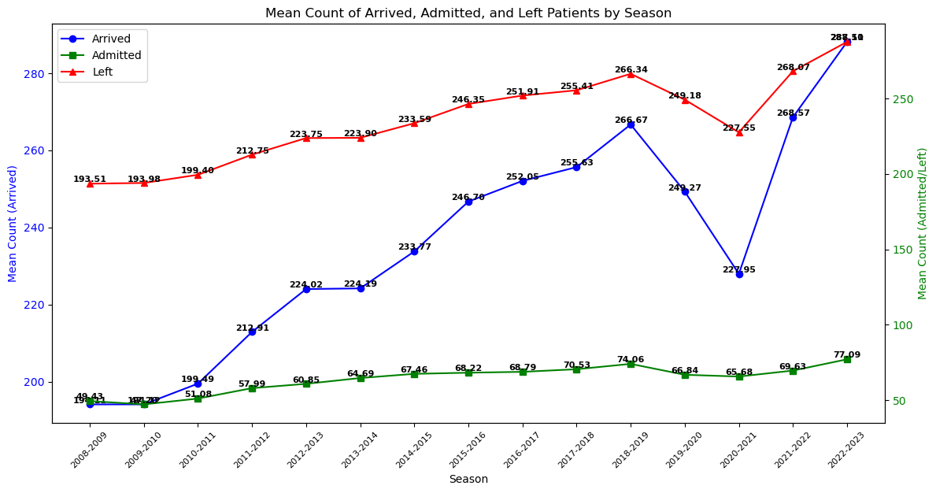
Figure 11 Mean of Patient Arrival, Admit, left for each season from 2009 to 2023.

Slide 26
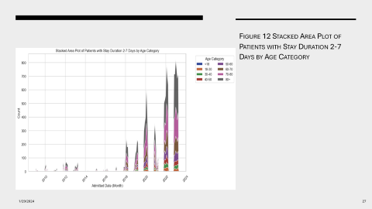
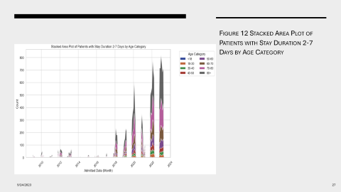
Result – 1- Comprehensive Analysis Key Summary
Patient Volumes & Variability: Gradual increase in mean daily patient arrivals from 2009 to 2023 with growing variability.
Hourly Fluctuations: Consistent hourly fluctuations in daily patient arrivals with peak periods during late morning (11 AM to 4 PM).
Intra-Week Demand: Fluctuations in weekly patient arrivals with Mondays as the busiest day.
Age Group Trends: The ageing population is reflected in increasing trends in <18 and older age groups.
Ambulance Usage: Fluctuating ambulance demand, peaking in 2014-2015 and gradually declining.
ED Stay Durations: Shift towards more extended ED stays post-2017, especially during COVID-19.
Arrival-Departure Equilibrium: Consistent balance between mean daily arrivals and departures, highlighting adaptability.
Extended Stay by Age: Older age groups, especially above 60, had higher proportions of extended stays.

Slide 27
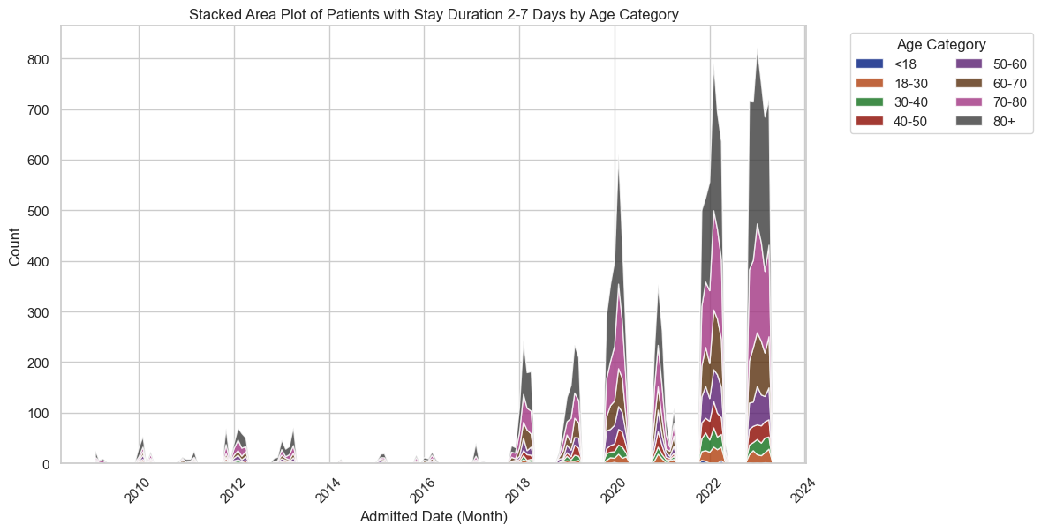
Figure 12 Stacked Area Plot of Patients with Stay Duration 2-7 Days by Age Category

Slide 28
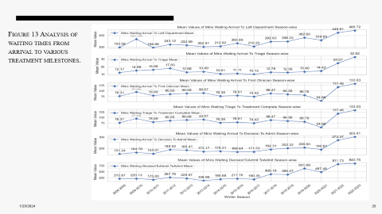

Result – 1- Comprehensive Analysis Key Summary
Patient Volumes & Variability: Gradual increase in mean daily patient arrivals from 2009 to 2023 with growing variability.
Hourly Fluctuations: Consistent hourly fluctuations in daily patient arrivals with peak periods during late morning (11 AM to 4 PM).
Intra-Week Demand: Fluctuations in weekly patient arrivals with Mondays as the busiest day.
Age Group Trends: The ageing population is reflected in increasing trends in <18 and older age groups.
Ambulance Usage: Fluctuating ambulance demand, peaking in 2014-2015 and gradually declining.
ED Stay Durations: Shift towards more extended ED stays post-2017, especially during COVID-19.
Arrival-Departure Equilibrium: Consistent balance between mean daily arrivals and departures, highlighting adaptability.
Extended Stay by Age: Older age groups, especially above 60, had higher proportions of extended stays.
Wait Time Variations: These are differences in how long patients wait for essential treatments in the ED. These variations indicate areas needing improvement to provide more timely care.

Slide 29
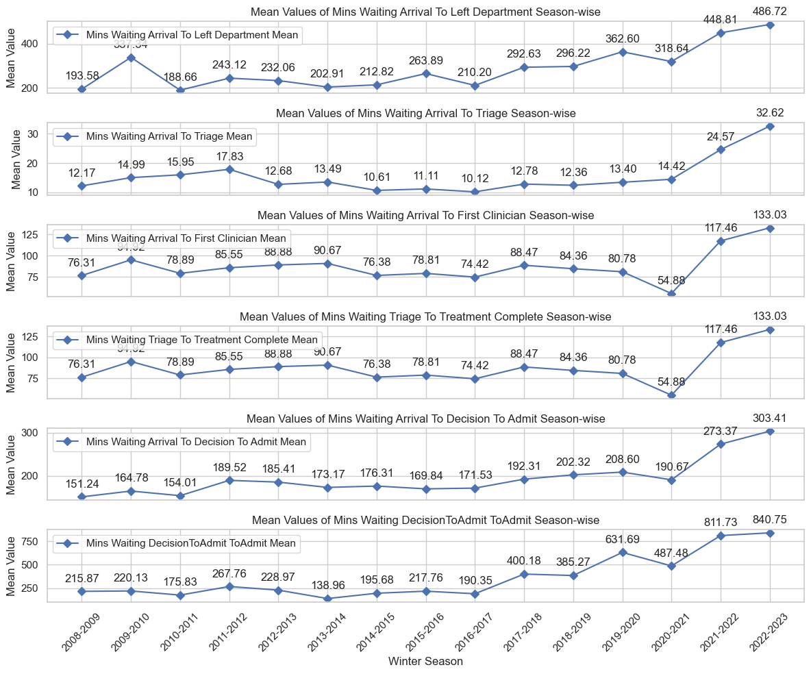
Figure 13 Analysis of waiting times from arrival to various treatment milestones.

Slide 30
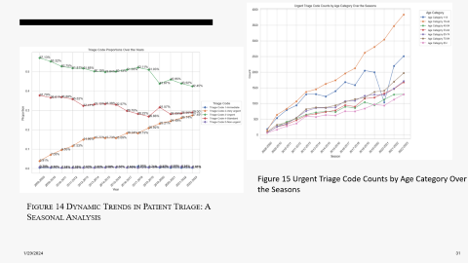
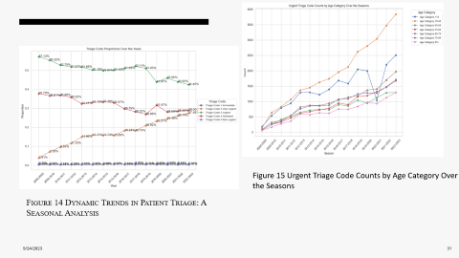
Result – 1- Comprehensive Analysis Key Summary
Patient Volumes & Variability: Gradual increase in mean daily patient arrivals from 2009 to 2023 with growing variability.
Hourly Fluctuations: Consistent hourly fluctuations in daily patient arrivals with peak periods during late morning (11 AM to 4 PM).
Intra-Week Demand: Fluctuations in weekly patient arrivals with Mondays as the busiest day.
Age Group Trends: The ageing population is reflected in increasing trends in <18 and older age groups.
Ambulance Usage: Fluctuating ambulance demand, peaking in 2014-2015 and gradually declining.
ED Stay Durations: Shift towards more extended ED stays post-2017, especially during COVID-19.
Arrival-Departure Equilibrium: Consistent balance between mean daily arrivals and departures, highlighting adaptability.
Extended Stay by Age: Older age groups, especially above 60, had higher proportions of extended stays.
Wait Time Variations: These are differences in how long patients wait for essential treatments in the ED. These variations indicate areas needing improvement to provide more timely care.
Triage Code Shifts: Statistical analysis of triage code distributions reveals significant shifts over time, emphasizing the critical need for adaptive resource allocation.

Slide 31
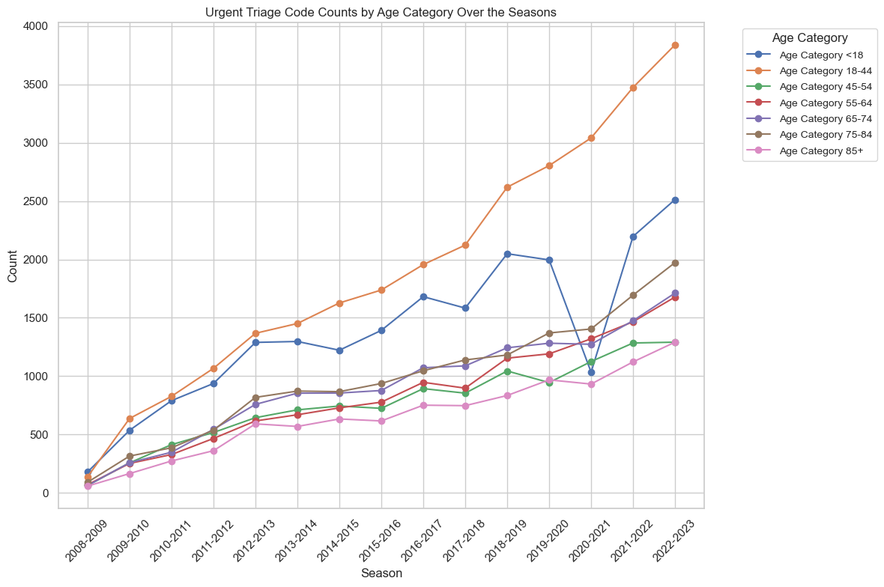
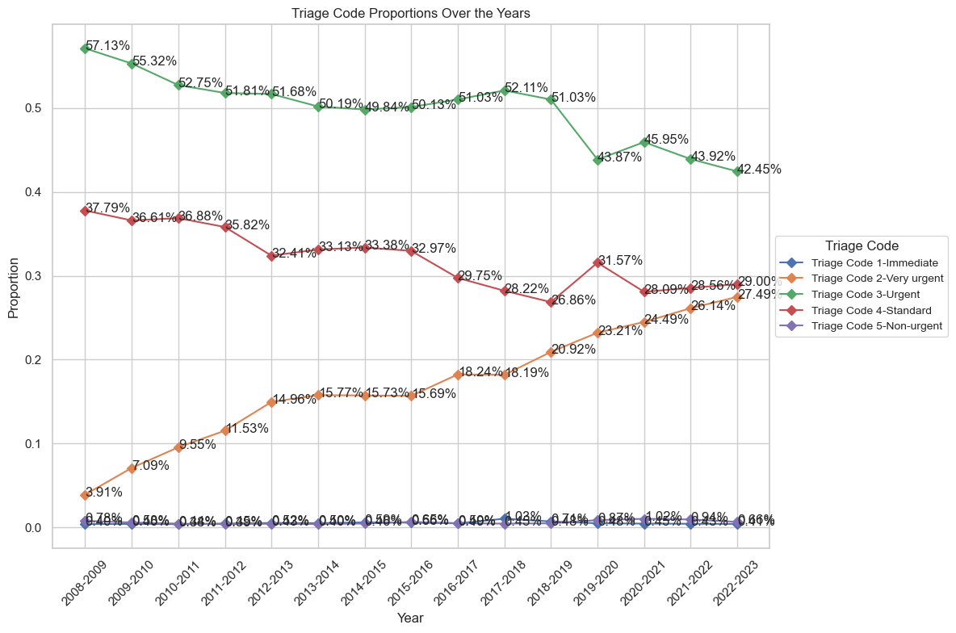
Figure 15 Urgent Triage Code Counts by Age Category Over the Seasons
Figure 14 Dynamic Trends in Patient Triage: A Seasonal Analysis

Slide 32
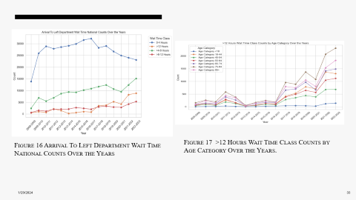

Result – 1- Comprehensive Analysis Key Summary
Patient Volumes & Variability: Gradual increase in mean daily patient arrivals from 2009 to 2023 with growing variability.
Hourly Fluctuations: Consistent hourly fluctuations in daily patient arrivals with peak periods during late morning (11 AM to 4 PM).
Intra-Week Demand: Fluctuations in weekly patient arrivals with Mondays as the busiest day.
Age Group Trends: The ageing population is reflected in increasing trends in <18 and older age groups.
Ambulance Usage: Fluctuating ambulance demand, peaking in 2014-2015 and gradually declining.
ED Stay Durations: Shift towards more extended ED stays post-2017, especially during COVID-19.
Arrival-Departure Equilibrium: Consistent balance between mean daily arrivals and departures, highlighting adaptability.
Extended Stay by Age: Older age groups, especially above 60, had higher proportions of extended stays.
Wait Time Variations: These are differences in how long patients wait for essential treatments in the ED. These variations indicate areas needing improvement to provide more timely care.
Triage Code Shifts: Statistical analysis of triage code distributions reveals significant shifts over time, emphasizing the critical need for adaptive resource allocation.
Age & Prolonged Stays: Correlation between older age and extended ED care, requiring longer evaluation.

Slide 33
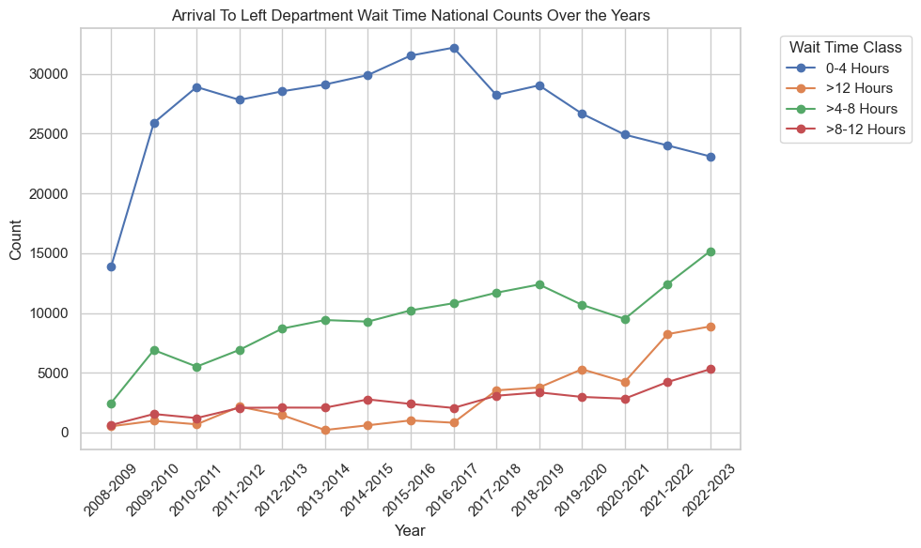
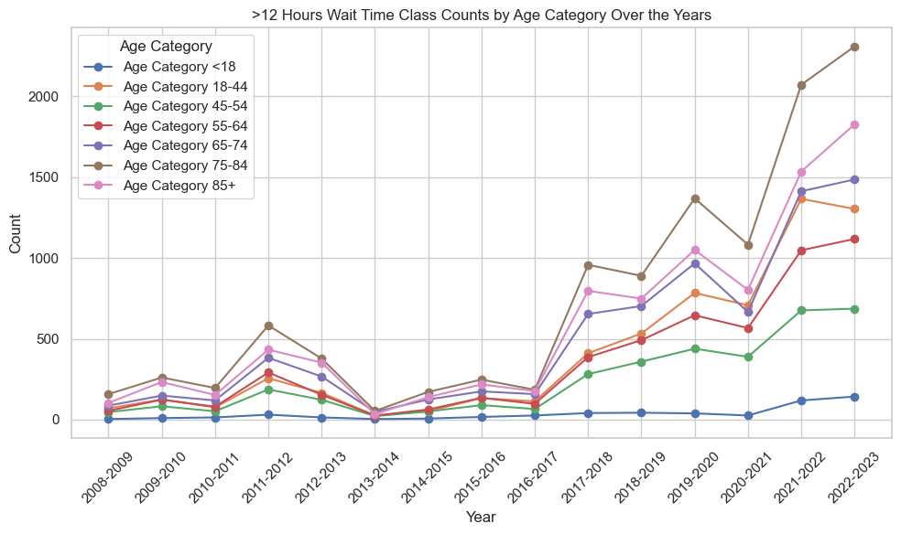
Figure 16 Arrival To Left Department Wait Time National Counts Over the Years
Figure 17 >12 Hours Wait Time Class Counts by Age Category Over the Years.

Slide 34
Result – 1- Comprehensive Analysis Key Summary
Patient Volumes & Variability: Gradual increase in mean daily patient arrivals from 2009 to 2023 with growing variability.
Hourly Fluctuations: Consistent hourly fluctuations in daily patient arrivals with peak periods during late morning (11 AM to 4 PM).
Intra-Week Demand: Fluctuations in weekly patient arrivals with Mondays as the busiest day.
Age Group Trends: The ageing population is reflected in increasing trends in <18 and older age groups.
Ambulance Usage: Fluctuating ambulance demand, peaking in 2014-2015 and gradually declining.
ED Stay Durations: Shift towards more extended ED stays post-2017, especially during COVID-19.
Arrival-Departure Equilibrium: Consistent balance between mean daily arrivals and departures, highlighting adaptability.
Extended Stay by Age: Older age groups, especially above 60, had higher proportions of extended stays.
Wait Time Variations: These are differences in how long patients wait for essential treatments in the ED. These variations indicate areas needing improvement to provide more timely care.
Triage Code Shifts: Statistical analysis of triage code distributions reveals significant shifts over time, emphasizing the critical need for adaptive resource allocation.
Age & Prolonged Stays: Correlation between older age and extended ED care, requiring longer evaluation.

Slide 35
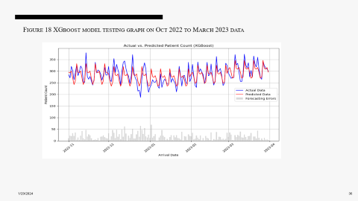

Data Analysis - Predictive Analysis
Predictive Model Performance for Daily Patient Arrival Forecasting (Table 4):
The predictive models for forecasting daily patient arrivals to the Emergency Department (ED) were evaluated on test data from October 2022 to March 2023. The features used included COVID status, month, day of week, season, and weekend indicators
Table 4 Model Performance Analysis for Daily Patient Arrival Forecasting in the ED

Slide 36
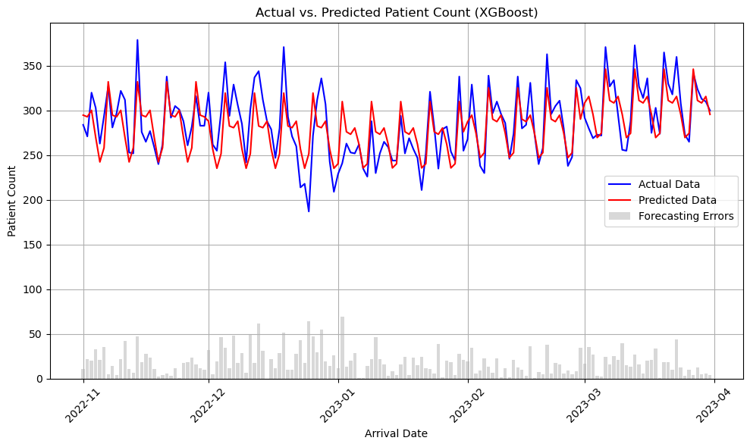
Figure 18 XGboost model testing graph on Oct 2022 to March 2023 data

Slide 37
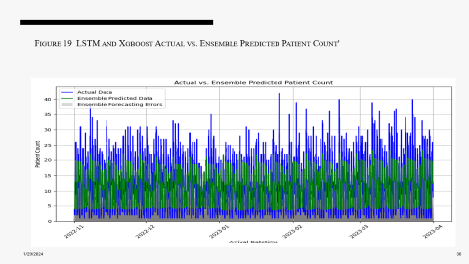

Data Analysis - Predictive Analysis
Hourly Patient Arrival Forecasting Model Performance (Table 5):
Hourly patient arrival forecasting models incorporated features like COVID status, month, day of the week, season, weekend indicators, and time of day encodings to capture potential patterns.
Table 5 Hourly Patient Arrival Forecasting Model Performance Comparison

Slide 38
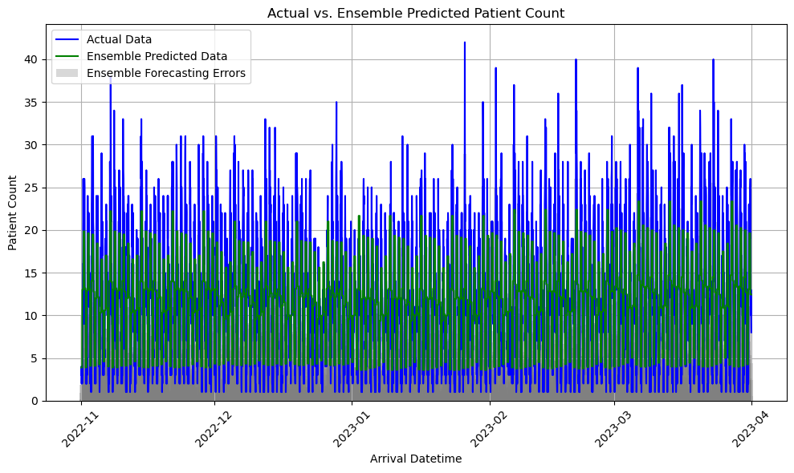
Figure 19 LSTM and Xgboost Actual vs. Ensemble Predicted Patient Count'

Slide 39
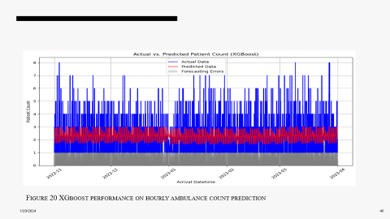

Data Analysis - Predictive Analysis
Model Performance for Hourly Ambulance Service Predictions (Table 6):
The focus of the models was on hourly ambulance demand predictions, given limited features for accurate daily forecasting. Inputs included COVID status, month, day of the week, season, weekends, hour of the day, and Before 2016 encoding.

Slide 40
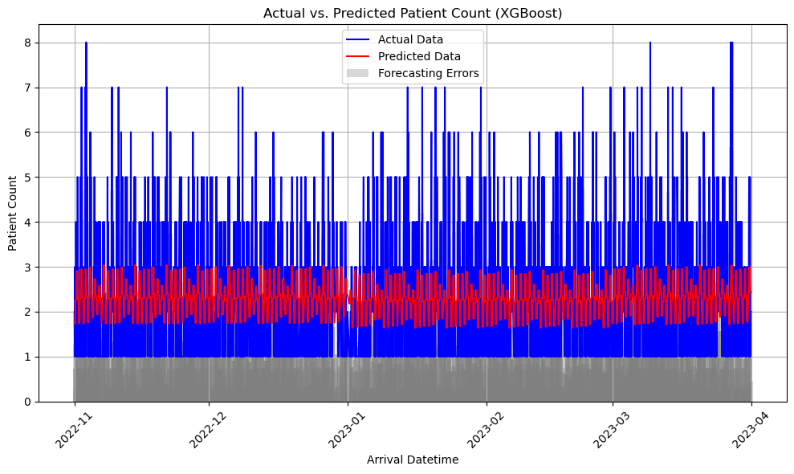
Figure 20 XGboost performance on hourly ambulance count prediction

Slide 41
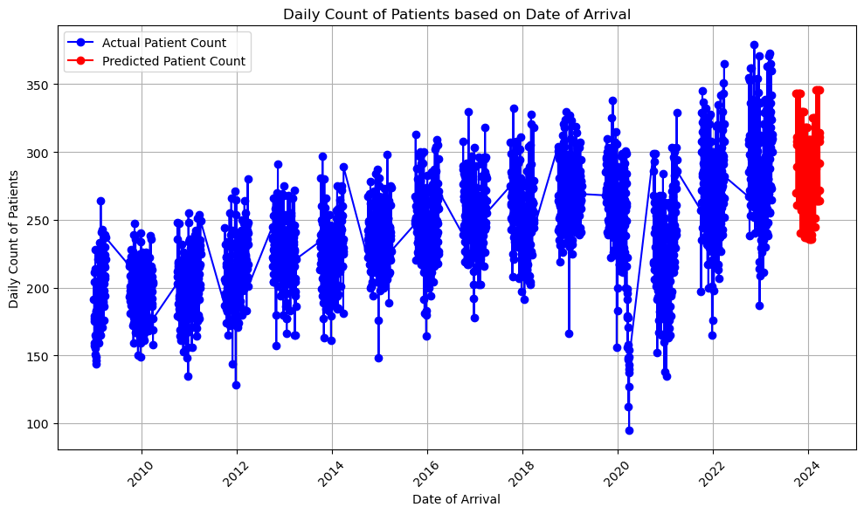
Patient Arrival Forecasting for Oct 2023 - Mar 2024
Figure 21 Daily Patient Arrivals Forecast for Oct 2023 - Mar 2024 Using XGBOOST

Slide 42
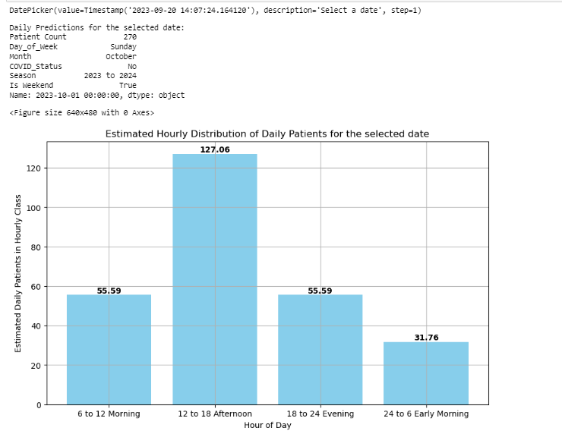
Patient Arrival Forecasting for Oct 2023 - Mar 2024
Interactive Hourly Patient Arrival Visualization
Hourly Prediction Model: Proportional Hourly Patient Arrival Estimation Utilizes historical data and machine learning algorithms to predict patient arrivals for distinct hourly intervals, offering flexible insights for resource planning, staff scheduling, and data-driven decision-making.

Slide 43
Discussion Highlights:
Understanding Winter Pressures: This analysis provides valuable insights into the increasing pressures faced by the NHS Emergency Department during the winter seasons from 2009 to 2023.
Escalating Patient Arrivals: The study reveals a consistent rise in daily patient arrivals, exceeding 280 in recent seasons, highlighting the growing winter demand.
Peak Arrival Times: Afternoon arrival spikes between 12-6 PM align with the results, indicating peak volumes during this period.
Vulnerable Elderly Population: The analysis confirms an increase in patients aged 70+, reflecting the challenges posed by older populations, especially those above 60, after 2015.
Prolonged ED Stays: The growth in stays exceeding 12 hours reinforces the findings of shifts toward prolonged ED care, particularly among older patients.
Predictive Modelling Impact: The predictive models, especially XGBoost, offer valuable insights for daily arrival estimates, aiding proactive planning.
Ensemble Strategy: Combining XGBoost and LSTM models provides optimization benefits for hourly volume projections, enhancing capacity planning during peak periods.
Room for Improvement: The ambulance demand forecast model may require further analysis and feature enhancement to enhance its accuracy and effectiveness, allowing for more refined planning.

Slide 44
Actionable Recommendations Based on Analysis Insights:
Expand ED Capacity: Pilot the expansion of Emergency Department (ED) capacity in high-demand locations, guided by predictive models, to accommodate projected 2023-2024 daily patient volumes of 280-320.
Surge Staffing: Implement surge staffing strategies, including additional clinicians during peak afternoon hours (12-6 PM), to manage historically heightened arrival rates, which can reach up to 20-25 patients per hour during this period.
Elderly Care Teams: Given the increasing proportion of patients aged 70+ from 10.5% to 11.3% over 14 years, allocate additional resources such as geriatric specialists and expand elderly care teams to address the specific needs of this growing demographic.
Rapid Assessment Protocols: To mitigate the concerning trend of stays exceeding 12 hours, adopt rapid assessment protocols aimed at evaluating and transferring patients within 6-8 hours where clinically appropriate.

Slide 45
Conclusion
Escalating Winter Pressures: Over the 14-year period from 2009 to 2023, NHS Emergency Departments have experienced a steady increase in daily patient arrivals, surpassing 280 in recent seasons, highlighting the critical need for proactive strategies.
Peak Demand Challenges: Afternoon patient arrivals peak at 20-25 per hour between 12-6 PM, demanding focused attention and strategic resource allocation during these hours to maintain efficient care delivery.
Weekly Patterns: Mondays consistently witness a 16% weekly influx, emphasizing the importance of tailored resource planning to manage the surge in patient arrivals at the beginning of each week.
Shifting Demographics: The proportion of patients aged 70+ has steadily risen to 11.3% over the years, underscoring the need for adapting care models to meet the unique needs of an aging population.
Data-Driven Solutions: Reliable predictive models, including XGBoost for daily predictions and XGBoost-LSTM ensembles for hourly projections, empower healthcare providers with tools to anticipate patient surges and optimize resource allocation. These findings and capabilities enable proactive data-driven solutions to enhance preparedness and care quality during challenging winter seasons.

Slide 46
Acknowledgement:
I would like to express my heartfelt gratitude to Mr. David Cathers, my company supervisor at the ICT Business Intelligence Department of South Eastern Health & Social Care Trust, and Ms. Faye Moorehead for their invaluable assistance in obtaining Emergency Department data. I am also deeply thankful to Professor Adele Marshall, who provided scientific guidance in shaping my research.

Slide 47
Thank you

Slide 48
References
Agarwal, A., 2018. Polynomial Regression [WWW Document]. Medium. URL https://towardsdatascience.com/polynomial-regression-bbe8b9d97491 (accessed 9.15.23).
Charlton-Perez, A.J., Aldridge, R.W., Grams, C.M., Lee, R., 2019. Winter pressures on the UK health system dominated by the Greenland Blocking weather regime. Weather Clim. Extrem. 25, 100218. https://doi.org/10.1016/j.wace.2019.100218
Chen, D., n.d. Centre for Clinical Effectiveness.
Keith, M., 2023. Exploring the LSTM Neural Network Model for Time Series [WWW Document]. Medium. URL https://towardsdatascience.com/exploring-the-lstm-neural-network-model-for-time-series-8b7685aa8cf (accessed 9.15.23).
NHS, england, n.d. Understanding Winter Pressures in A&E Departments.
NHS, E., n.d. Improving care for older people [WWW Document]. URL https://www.england.nhs.uk/ourwork/clinical-policy/older-people/improving-care-for-older-people/ (accessed 9.15.23).
Parliament, U., 2016. House of Commons - Winter pressure in accident and emergency departments - Health Committee [WWW Document]. URL https://publications.parliament.uk/pa/cm201617/cmselect/cmhealth/277/27706.htm (accessed 9.15.23).
Plewes, J., Bulut, M., 2023. Analysis: what does the urgent and emergency care sitrep data 2022/23 tell us? | NHS Confederation [WWW Document]. URL https://www.nhsconfed.org/analysis-what-does-the-urgent-and-emergency-care-sitrep-data-2022/23-tell-us (accessed 8.18.23).
Winter pressures - NHS Providers [WWW Document], n.d. URL https://nhsproviders.org/topics/delivery-and-performance/winter-pressures (accessed 9.14.23).

Slide 49

appendices

Slide 50
Result – 1- Comprehensive Analysis
Analysis shows a rising trend in mean daily patient arrivals and increased variability across winter seasons from 2009 to 2023, with a temporary reduction in arrivals during 2019-2021 due to COVID-19 but subsequent recovery, providing insights for resource planning
Analysis of hourly proportions in daily patient arrivals from 2009 to 2023 unveils consistent fluctuations, with lows of 1.05-1.26% in the early morning (3-5 AM) and peaks of 6.23-7.66% in the late morning to early afternoon (11 AM-4 PM). The late night and early morning hours (11 PM-5 AM) consistently exhibit the lowest proportions of 1.26-2.70%, emphasizing mid-day as the busiest period and informing temporal resource optimization.
Analysis of weekly patient arrival proportions from 2009 to 2023 reveals day-to-day variations, with Mondays consistently having the highest influx (16.1%) and Sundays the lowest (13.8%). This highlights the need for tailored staff scheduling and service planning. Additionally, there's a consistent increase in Monday arrivals over the seasons.
Analysis of age group proportions from 2009 to 2022-2023 winters indicates a decline in the <18 groups from 22.9% to 21.8%, while the 50-60 and 60-70 groups show increasing trends from 9.2% to 10.7% and 8.6% to 10.5%, respectively. The 80+ group also rose from 10.5% to 11.3%, reflecting population ageing

Slide 51
Result – 1- Comprehensive Analysis
Ambulance usage data from 2009 to 2023 shows rising demand until peaking in 2014-2015 at 10,757 patients (7.8%), followed by a decreasing trend, with post-2016 seasons ranging from 6,000-8,234 patients (6.0-7.8%). This decline after 2016 may be due to resource limitations.
Variation in 1-7 day ED stays from 2009-2022, with a peak in 2021 (25 patients) and none over 7 days, highlights the ED's acute care focus. For 170,679 patients from 2009-2023, most stayed under 24 hours (91%), but <24-hour stays declined after 2016-2017, and 1-7 day stays rose post-2017, particularly during COVID-19, indicating a shift towards longer ED care needs
Consistent equilibrium in daily arrivals and departures across seasons (e.g., 193 arrivals and 192 departures in 2009) highlights the ED's efficiency, even during higher volumes (e.g., 268 arrivals and 267 departures in 2021-2022). This balance is maintained, ensuring prompt care delivery.
Fewer extended stays observed in younger age groups (<18 and 18-30) compared to significant cases among older groups (60-70 and 70-80+), with notable increases in the latter from 2018 onwards, highlighting the need for more prolonged ED care for older patients and guiding resource allocation.

Slide 52
Result – 1- Comprehensive Analysis
Fluctuations in mean waiting times observed across winter seasons for key treatment milestones, including arrival to department exit, triage, first clinician, and triage to treatment complete, indicate variations in patient flow and highlight the need for performance benchmarking.
Triage code distributions from 2009 to 2022-2023 revealed changes, with "3-Urgent" initially dominant but declining over time. "4-Standard" and "2-Very urgent" fluctuated. In 2017-2018, "3-Urgent" and "1-Immediate" rose, reflecting increasing urgent needs. In 2022-2023, "3-Urgent" remained the largest segment but declined to 42.45%, highlighting the importance of resource adaptation. Analysis of triage code counts by age group showed consistent patterns, with the 18-44 age group having the highest counts, and higher counts across codes and age groups from 2015-2016 onwards, signifying growing medical urgency
Analysis of arrival-to-department exit wait times revealed that while 64% of patients were attended to within 0-4 hours initially, there has been a concerning shift towards prolonged ED stays, especially after 2016. Additionally, an age correlation was observed, with older patient groups, particularly those aged 75+, showing an increasing proportion of >8-hour and >12-hour stays after 2015, indicating a higher need for extended evaluation and care.

